Slide 1
Print

Slide 2
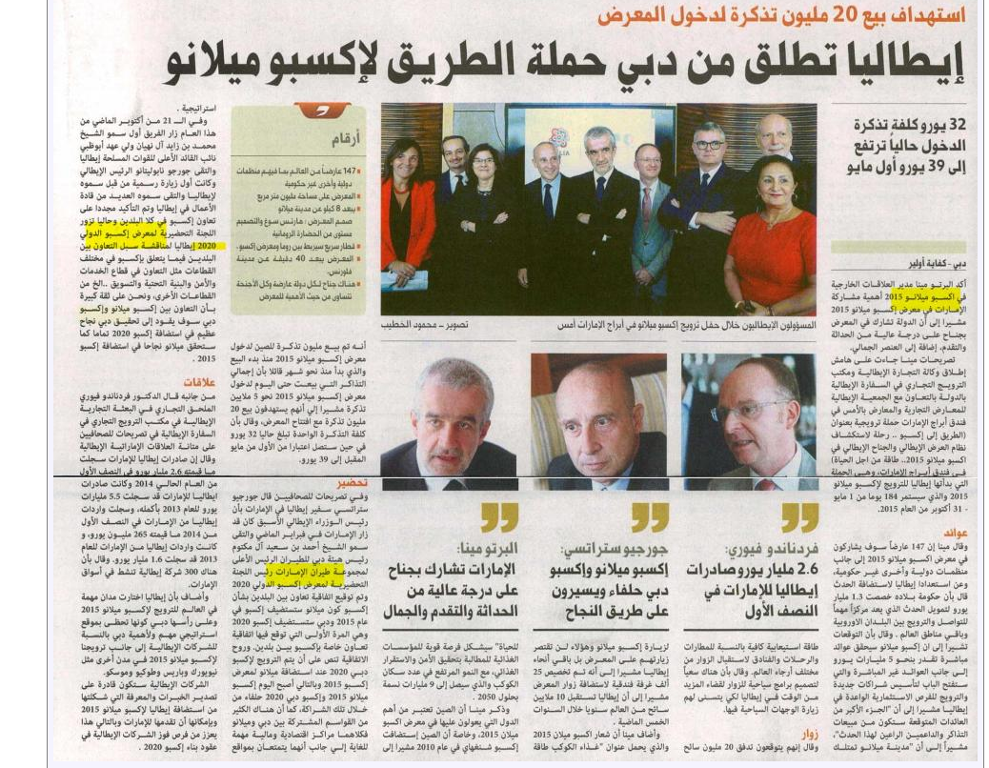
Publication | Type | Circulation/ Impressions | Date | Subject | AD value
Al Bayan | Newspaper | 88,800 | Nov 6,2014 | Italy Launches from Dubai Campaning to Expo Millan | $4,521

Slide 3
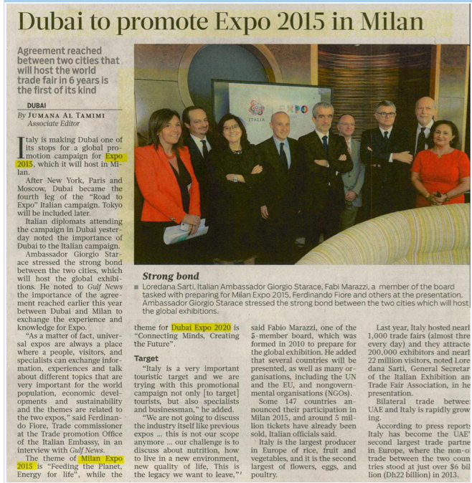
Publication | Type | Circulation/ Impressions | Date | Subject | AD value
Gulf News | Daily Newspaper | 123444 | 06 Nov 2014 | DUBAI TO PROMOTE EXPO 2015 IN MILAN | $ 6117

Slide 4
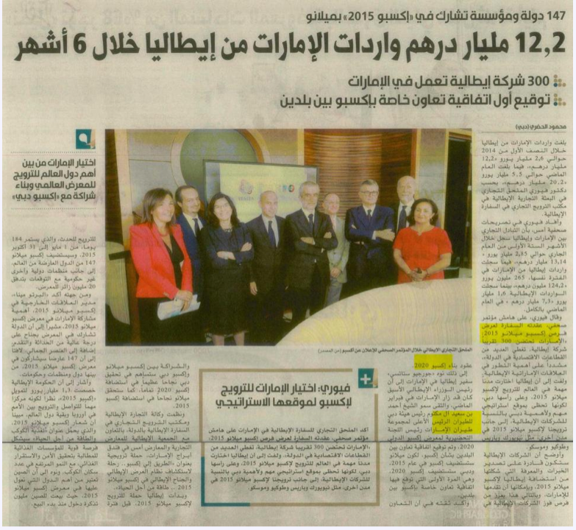
Publication | Type | Circulation/ Impressions | Date | Subject | AD value
AL Ittihad | Newspaper | 94,275 | 11/6/14 | 13 Billion Trade Between The Uae And Italy In First Half | $3,448.00

Slide 5
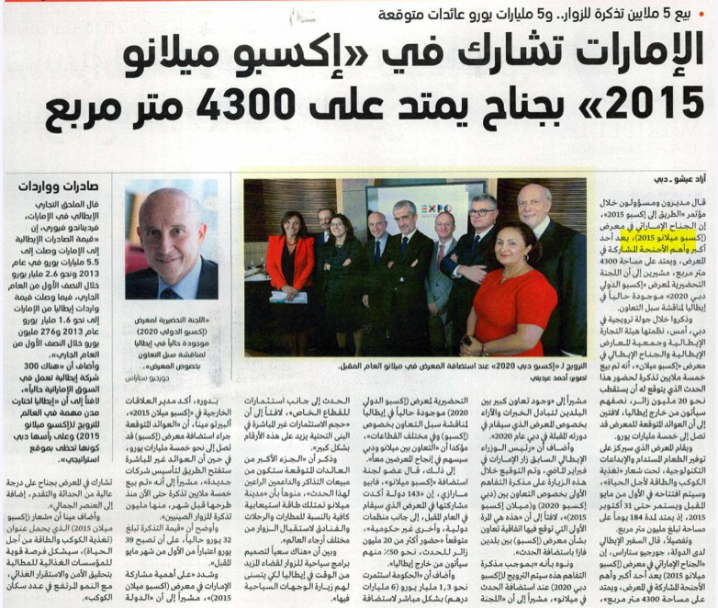
Publication | Type | Circulation/ Impressions | Date | Subject | AD value
Emaratelyoum | Newspaper | 100,000 | Nov. 6 2014 | UAE Participates in Expo Milan 2015 | $ 5086

Slide 6
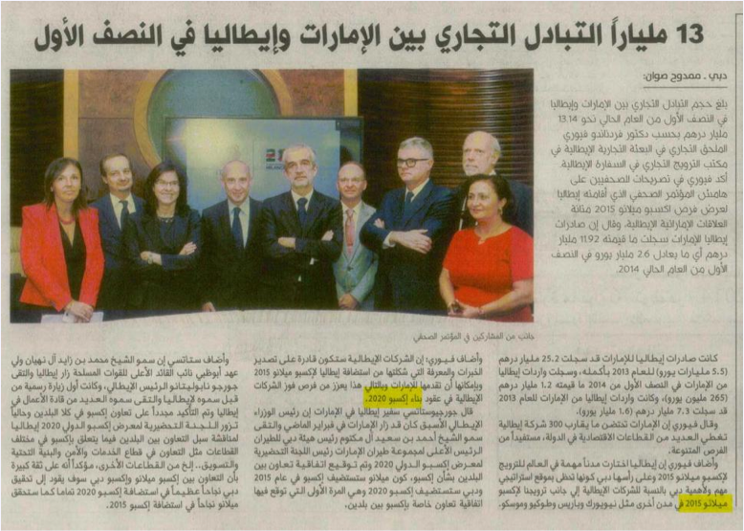
Publication | Type | Circulation/ Impressions | Date | Subject | AD value
AL Khaleej | Newspaper | 150,000.00 | Nov. 6,2014 | 13 Bilion Trade Between UAE and Italy | $1,614.00

Slide 7
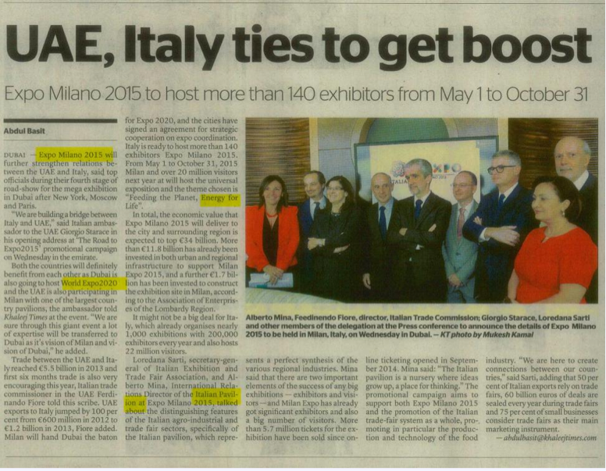
Publication | Type | Circulation/ Impressions | Date | Subject | AD value
Khaleej Times | Newspaper | 75135 | 11/6/14 | Uae,italy Ties To Get Boost | $4,434.00

Slide 8
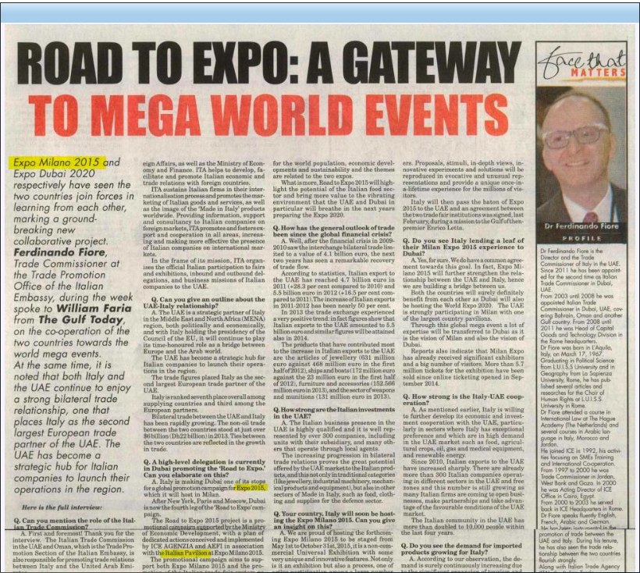
Publication | Type | Circulation/ Impressions | Date | Subject | AD value
Gulf Today | Newspaper | 46,200 | Nov. 8,2014 | Road to Expo A Gatway to Mega wolrd events | $ 3,260

Slide 9
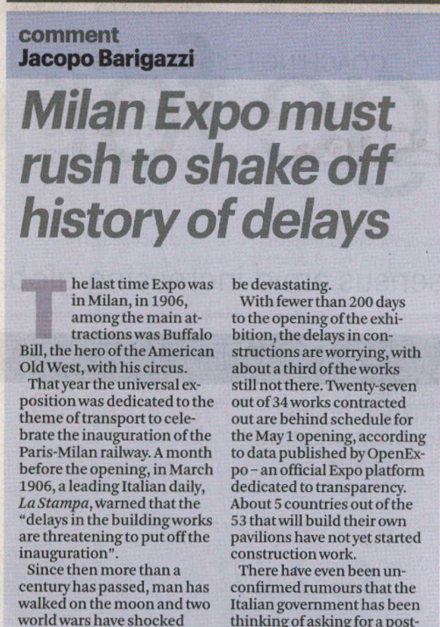
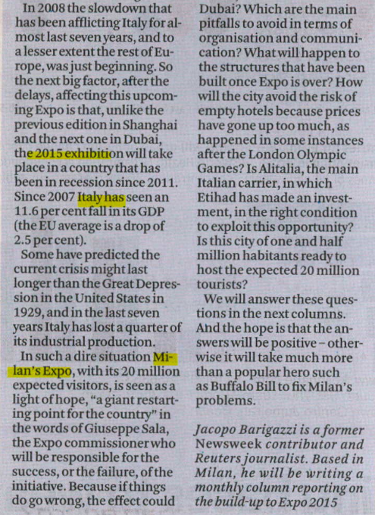
Publication | Type | Circulation/ Impressions | Date | Subject | AD value
The National | Newspaper | 90000 | Nov 9,2014 |  | $4,434.00

Slide 10
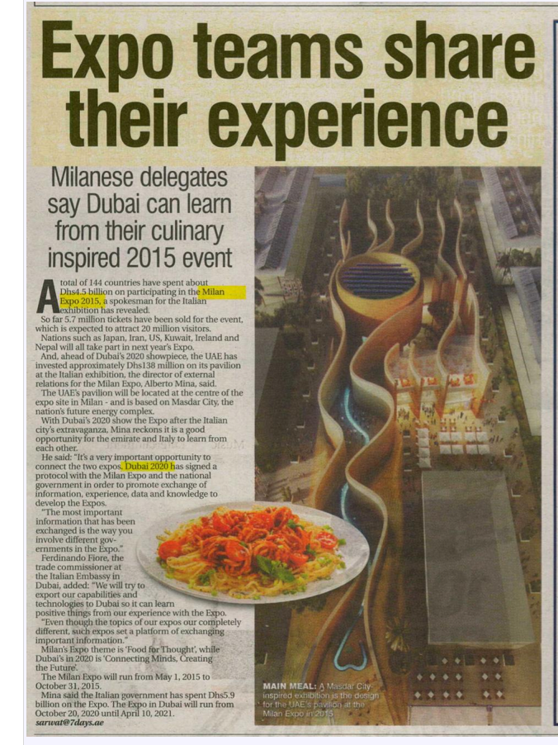
Publication | Type | Circulation/ Impressions | Date | Subject | AD value
7 Days | Newspaper | 67,123.00 |  | 11/10/14 | $1,479.00

Slide 11
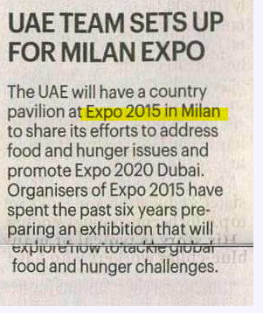
Publication | Type | Circulation/ Impressions | Date | Subject | AD value
The National | Newspaper | 90000 | 10 Nov 2014 | UAE TEAM SETS UP FOR MILAN EXPO | $ 155

Slide 12
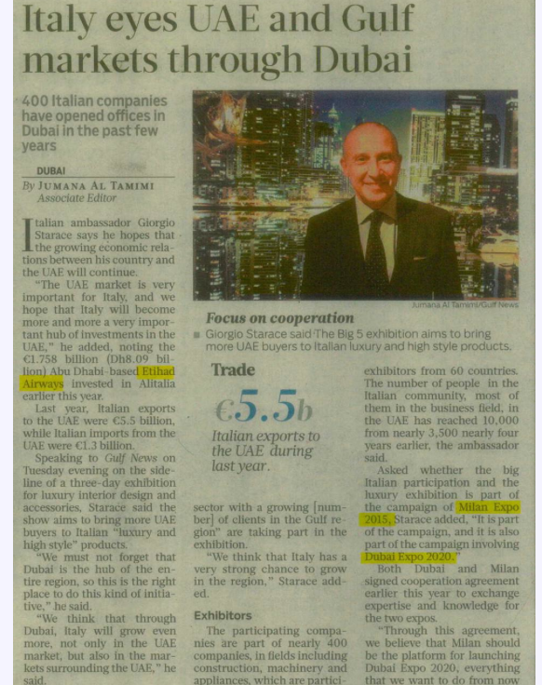
Publication | Type | Circulation/ Impressions | Date | Subject | AD Value
Gulf News | DNWP | 1,23,444 | 20/11/2014 | ITALY EYES UAE AND GULF MARKETS THROUGH DUBAI | $ 4587

Slide 13
Online

Slide 14
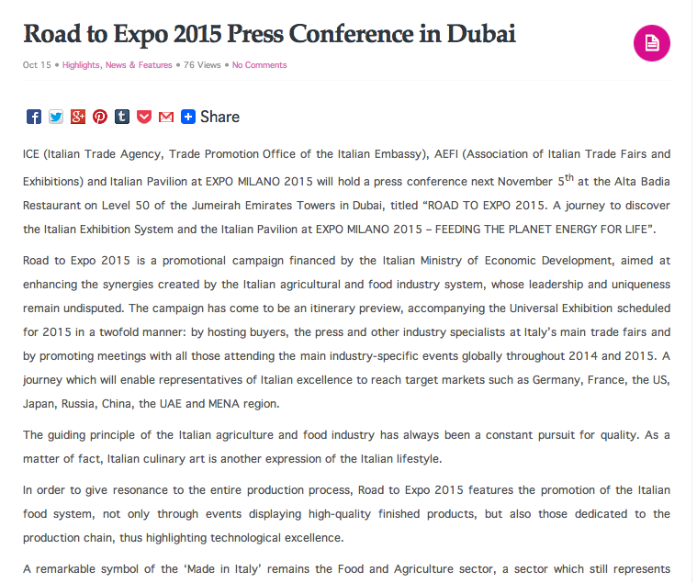
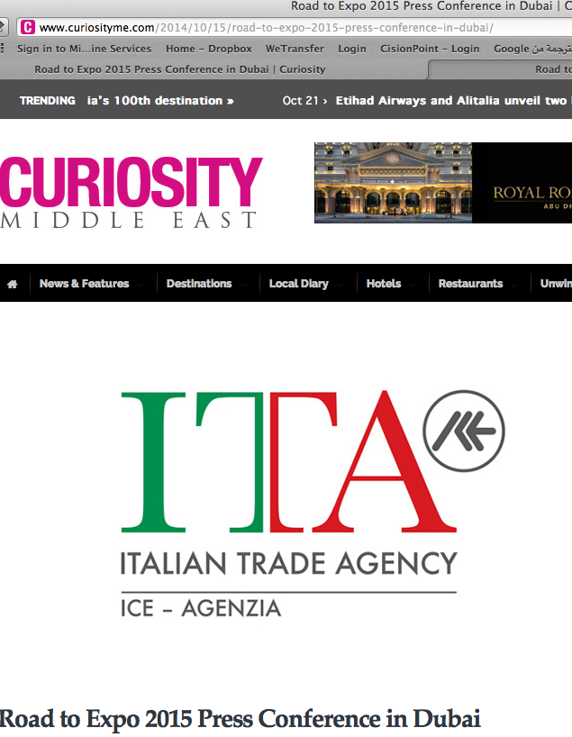
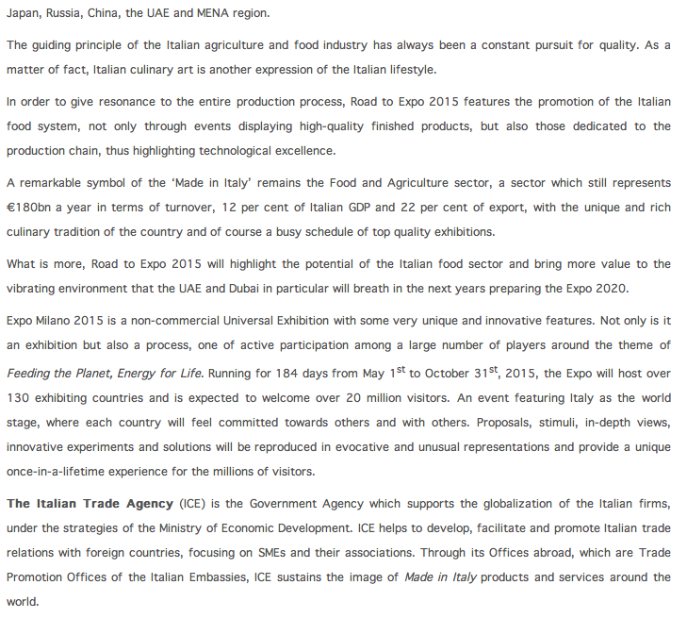
Publication | Type | Circulation/ Impressions | Date | Subject | AD value
Curiosityme.com | News Website | 5,212 Unique visitor per month | Oct 20,2014 | Expo Milan | $ 3,250.00

Slide 15
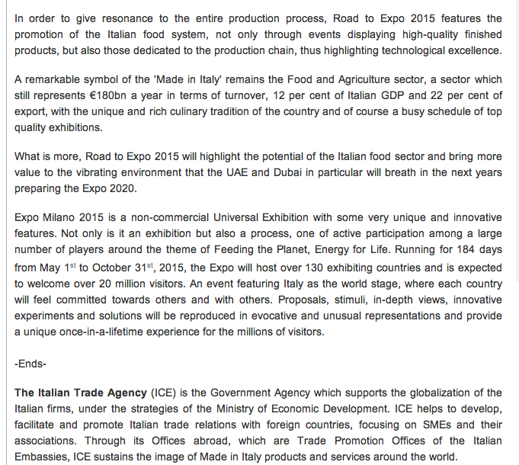
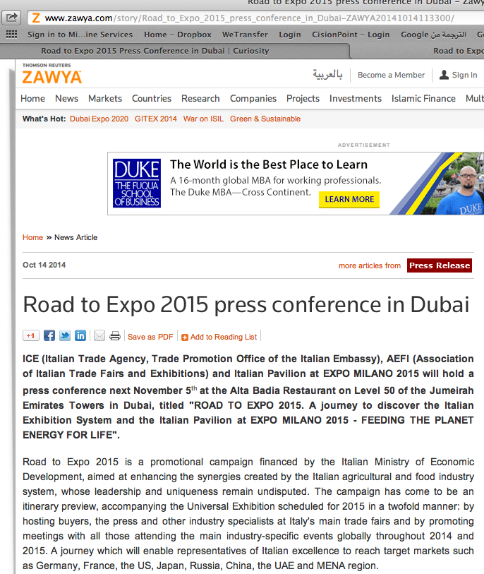
Publication | Type | Circulation/ Impressions | Date | Subject | AD value
Zawya | News Website | 411,007 | Oct,14 2015 | Road to Expo 2015 press conference in Dubai | $ 3,250.00

Slide 16
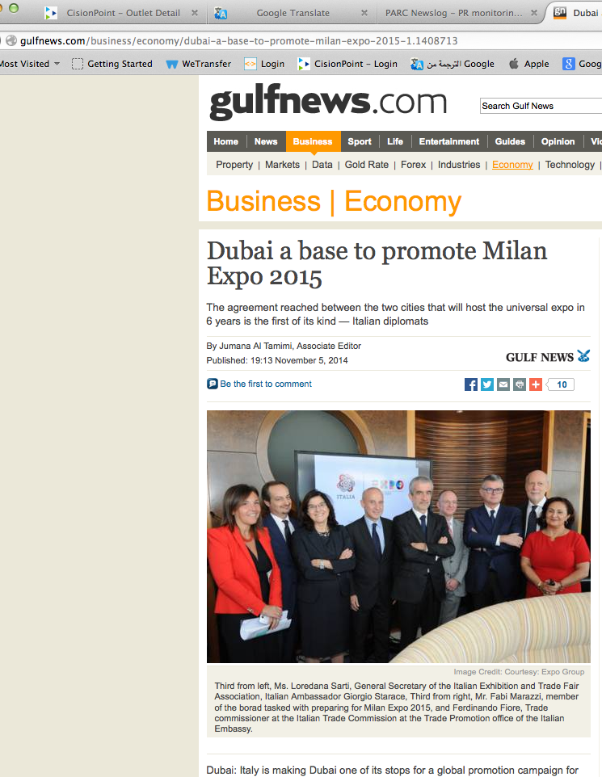
Publication | Type | Circulation/ Impressions | Date | Subject | AD value
Gulf News | News Website | 5,792 | Nov , 5,2014 | Dubai a base to promote Milan Expo 2015 | $ 3,250.00

Slide 17
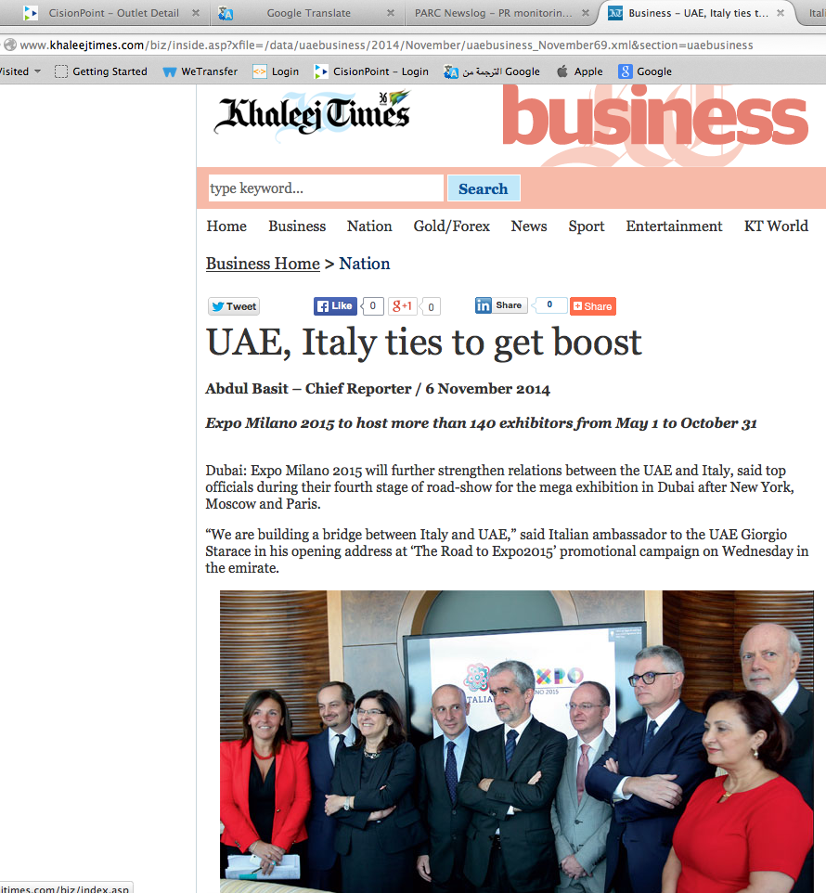
Publication | Type | Circulation/ Impressions | Date | Subject | AD value
khaleej Times | News Website | 477,066 | Nov , 6,2015 | UAE, Italy ties to get boost | $ 3,250.00

Slide 18
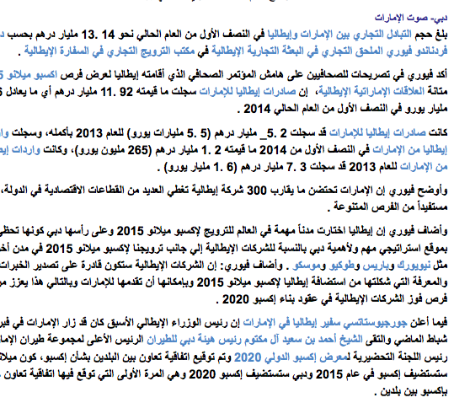
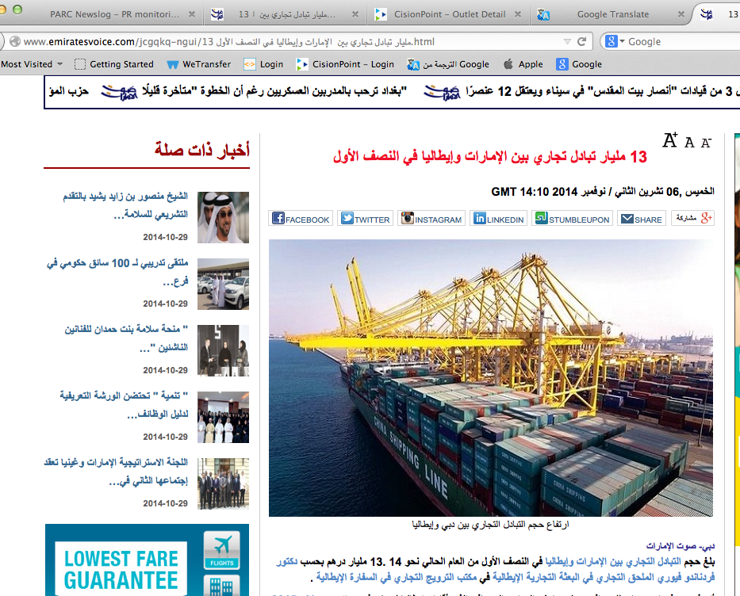
Publication | Type | Circulation/ Impressions | Date | Subject | AD value
Emirates Voice | News Website |  | Nov , 6,2015 | Road to Expo 2015 press conference in Dubai | $ 3,250.00

Slide 19
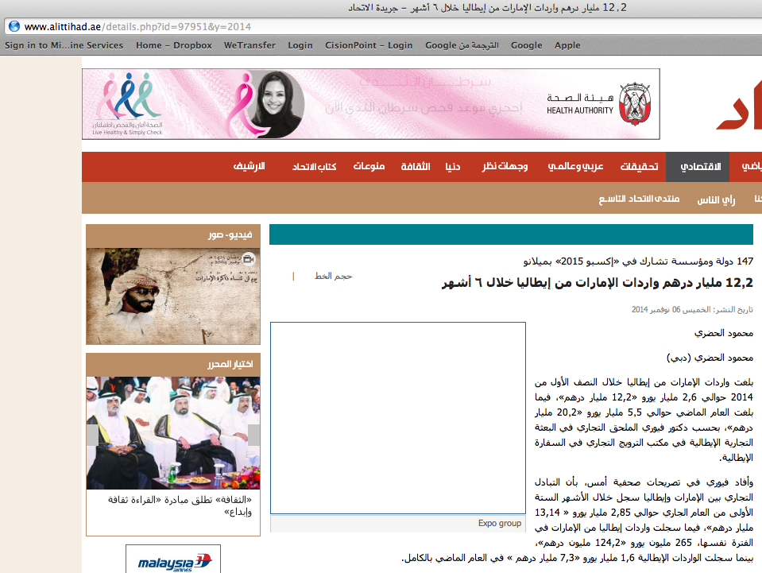
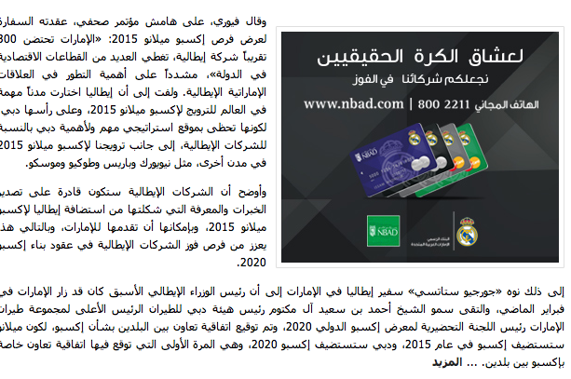
Publication | Type | Circulation/ Impressions | Date | Subject | AD value
Al Ittihad | News Website | 393,165 | Nov , 6,2017 | Road to Expo 2015 press conference in Dubai | $ 3,250.00

Slide 20
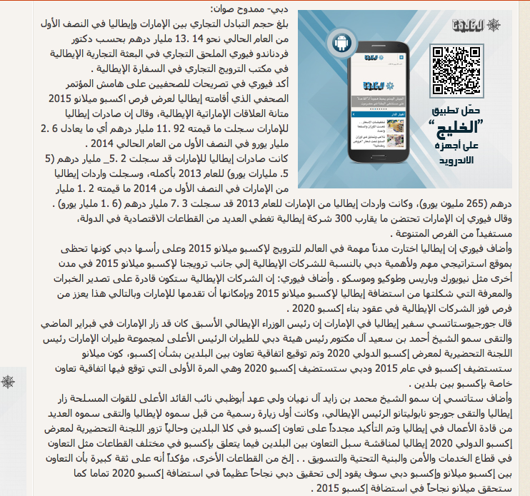
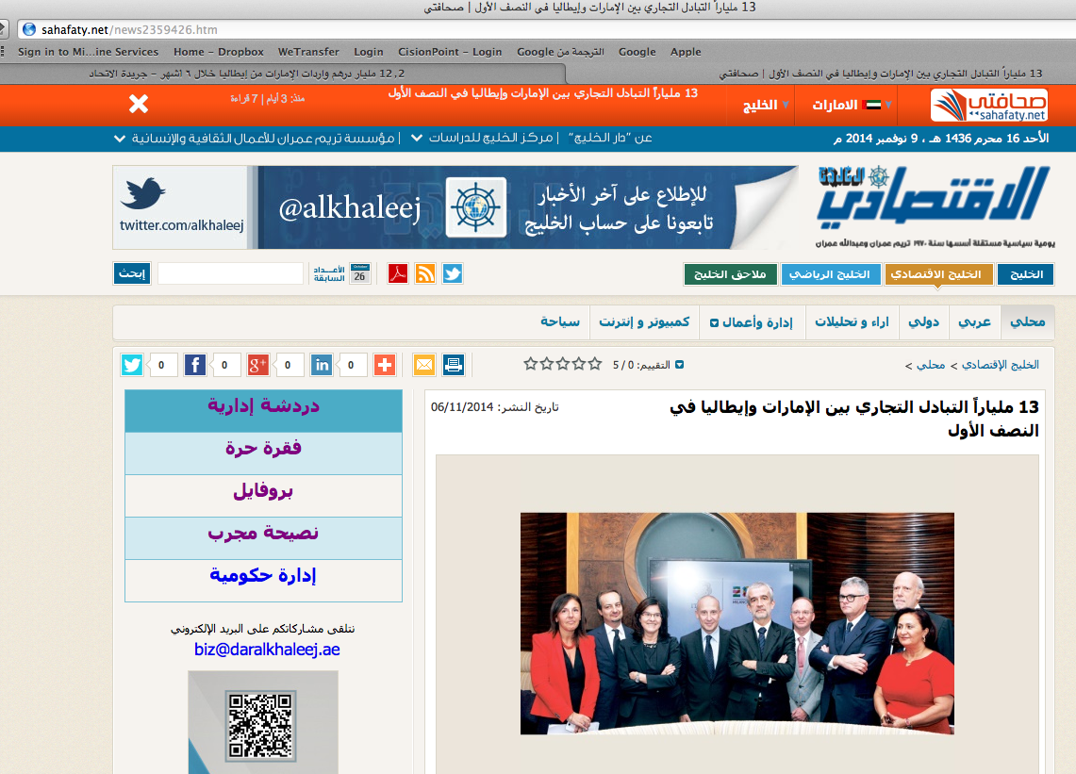
Publication | Type | Circulation/ Impressions | Date | Subject | AD value
Sahafaty | News Website |  | Nov , 6,2017 | Road to Expo 2015 press conference in Dubai | $ 3,250.00

Slide 21
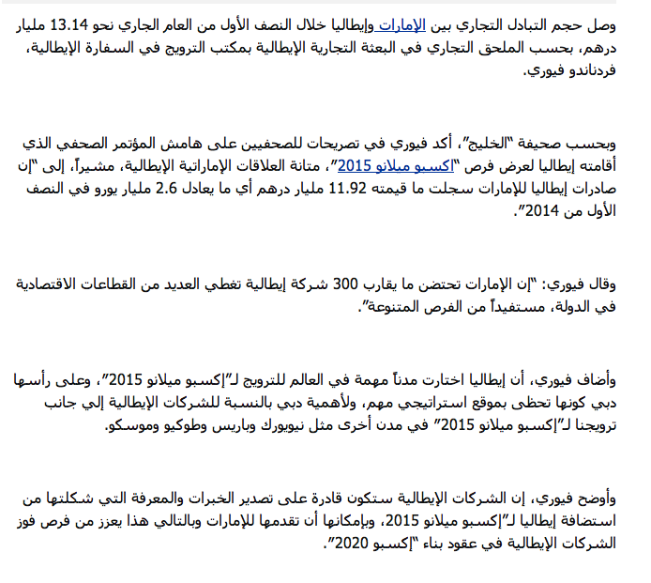
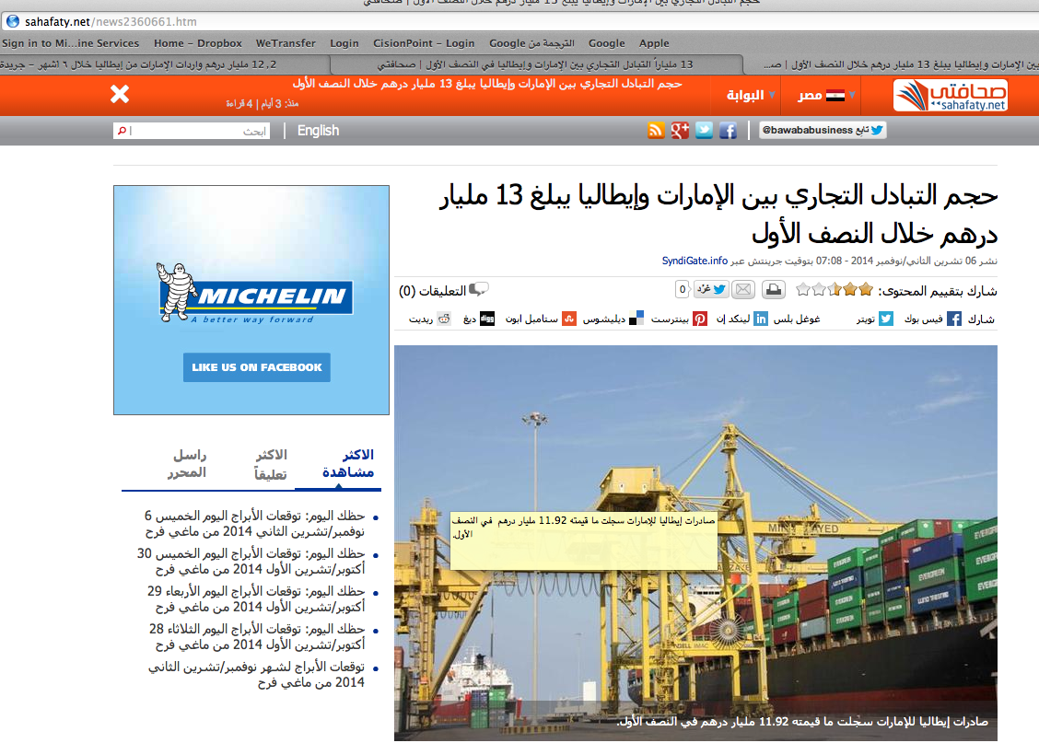
Publication | Type | Circulation/ Impressions | Date | Subject | AD value
Sahafaty | News Website |  | Nov , 6,2017 | Road to Expo 2015 press conference in Dubai | $ 3,250.00

Slide 22
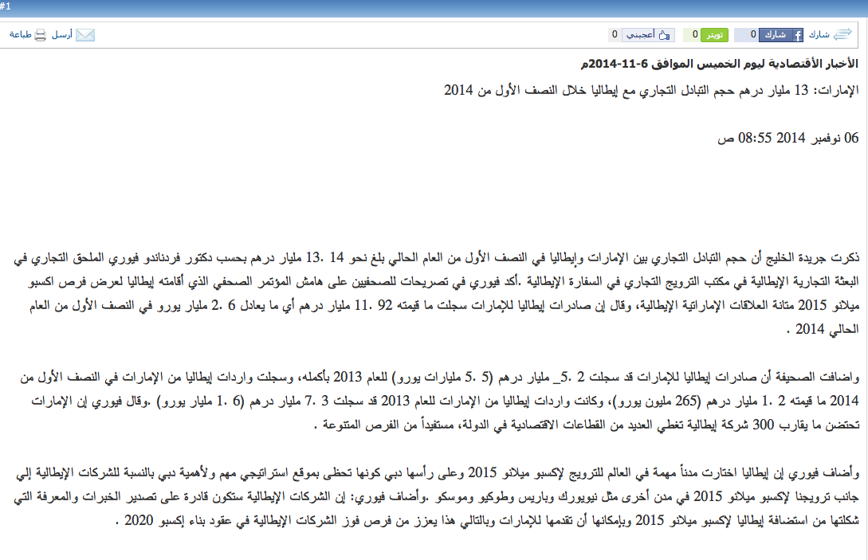
Publication | Type | Circulation/ Impressions | Date | Subject | AD value
Maktoob | News Website | 66,598 | Nov , 6,2017 | Road to Expo 2015 press conference in Dubai | $ 3,250.00

Slide 23
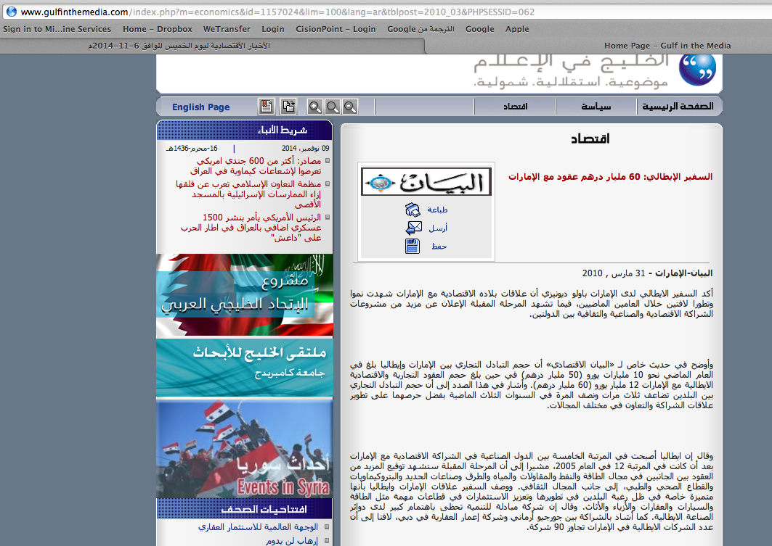
Publication | Type | Circulation/ Impressions | Date | Subject | AD value
Gulf in the Media | News Website |  | Nov , 6,2017 | Road to Expo 2015 press conference in Dubai | $ 3,250.00

Slide 24
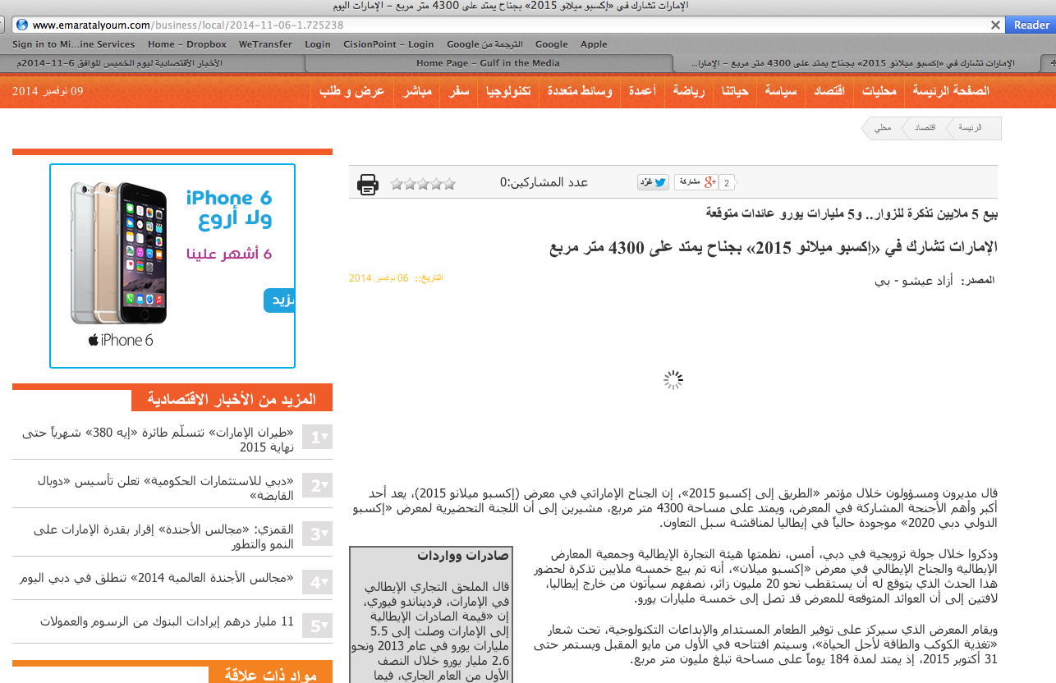
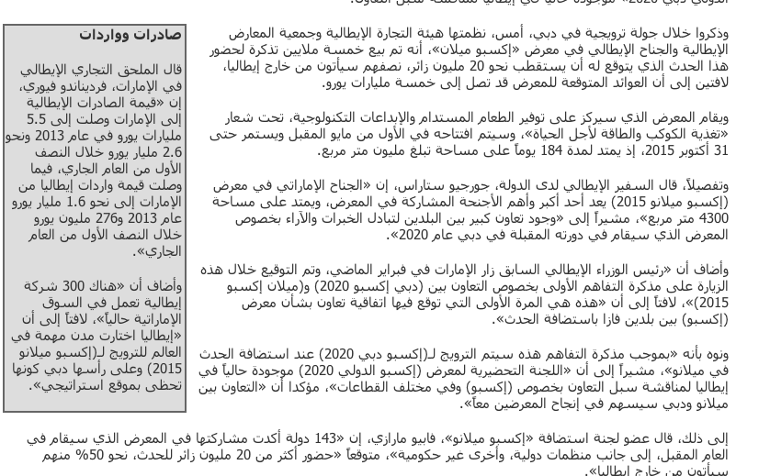
Publication | Type | Circulation/ Impressions | Date | Subject | AD value
Emaratalyoum | News Website | 1,049,853 | Nov , 6,2017 | Road to Expo 2015 press conference in Dubai | $ 3,250.00

Slide 25
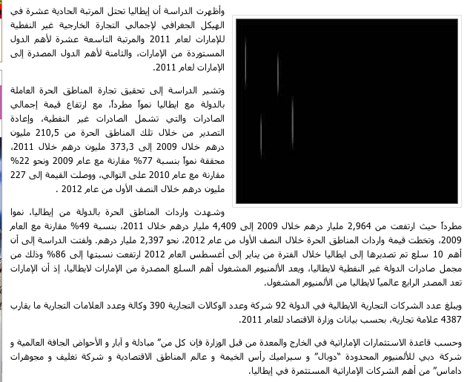
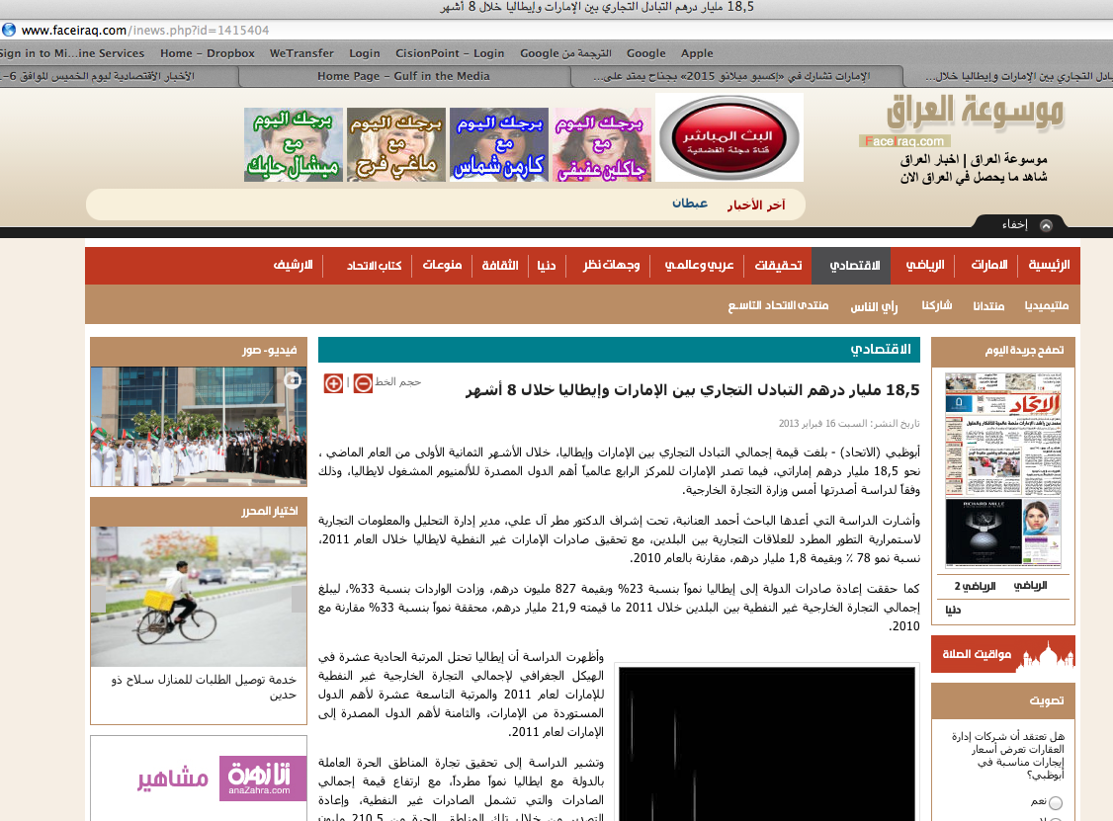
Publication | Type | Circulation/ Impressions | Date | Subject | AD value
Face Irarq | News Website |  | Nov , 6,2017 | Road to Expo 2015 press conference in Dubai | $ 3,250.00

Slide 26
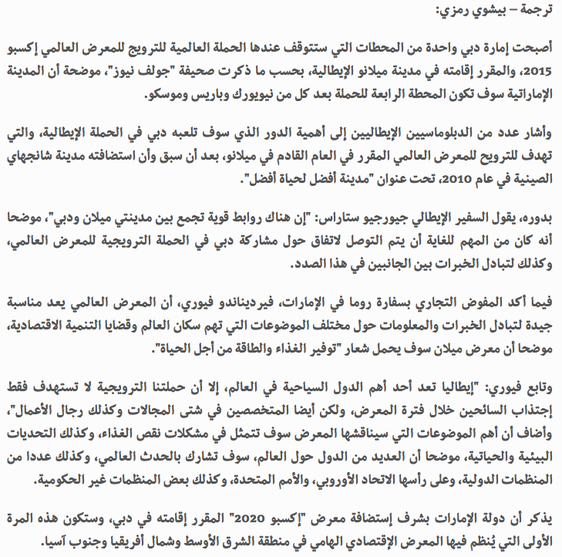
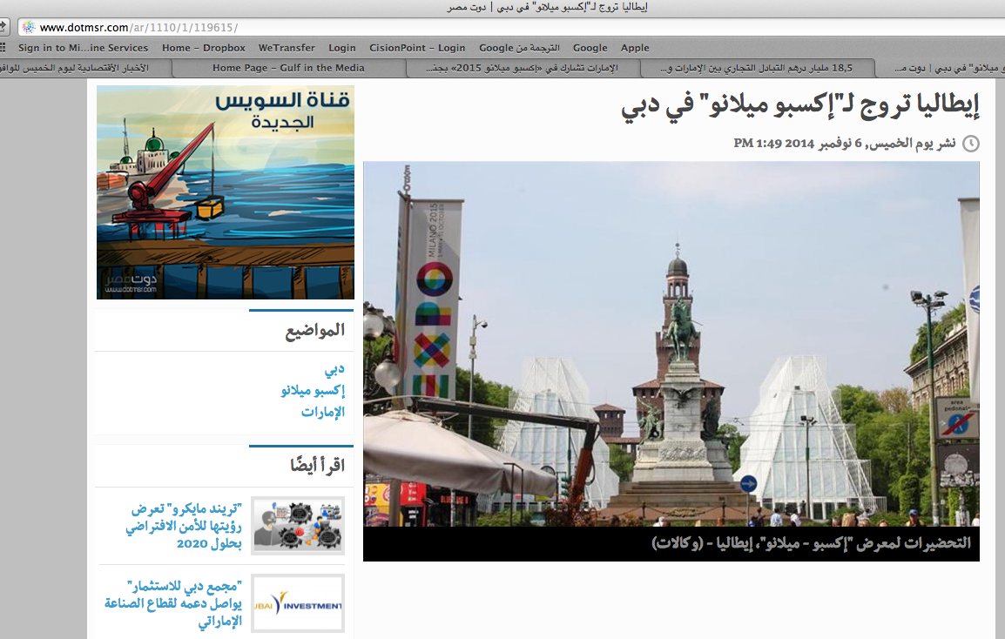
Publication | Type | Circulation/ Impressions | Date | Subject | AD value
Dot msr | News Website |  | Nov , 6,2017 | Road to Expo 2015 press conference in Dubai | $ 3,250.00

Slide 27
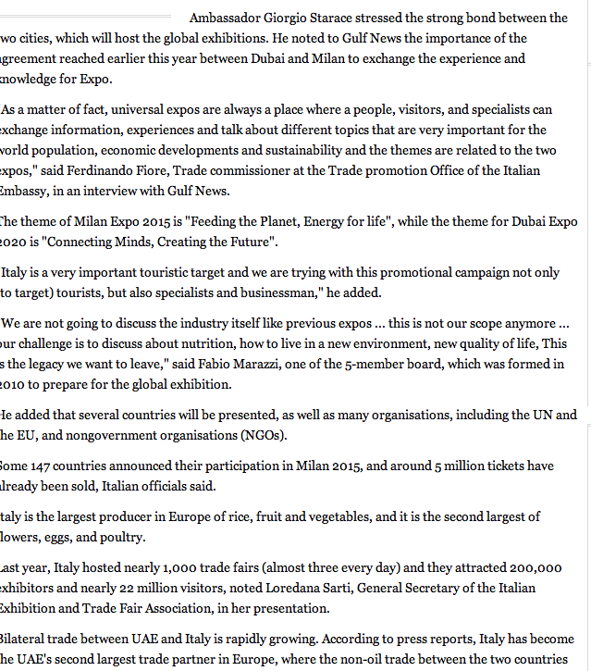
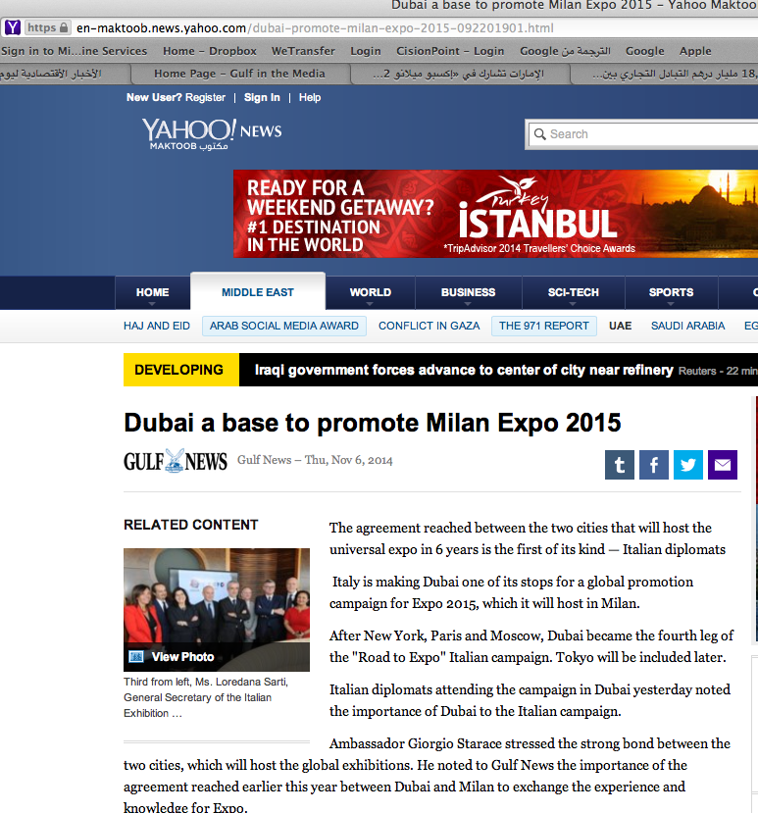
Publication | Type | Circulation/ Impressions | Date | Subject | AD value
Maktoob News | News Website | 16,850,648 | Nov , 6,2017 | Road to Expo 2015 press conference in Dubai | $ 3,250.00

Slide 28
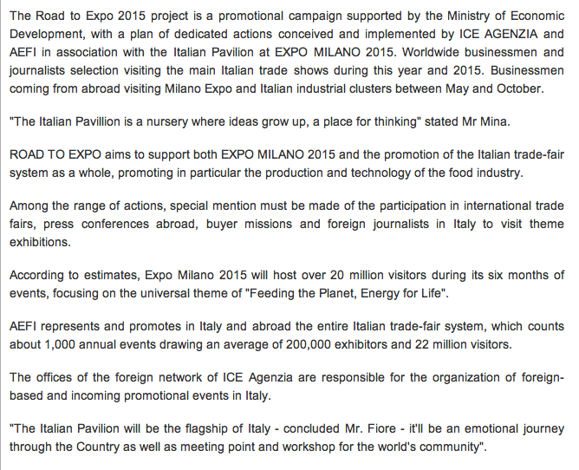
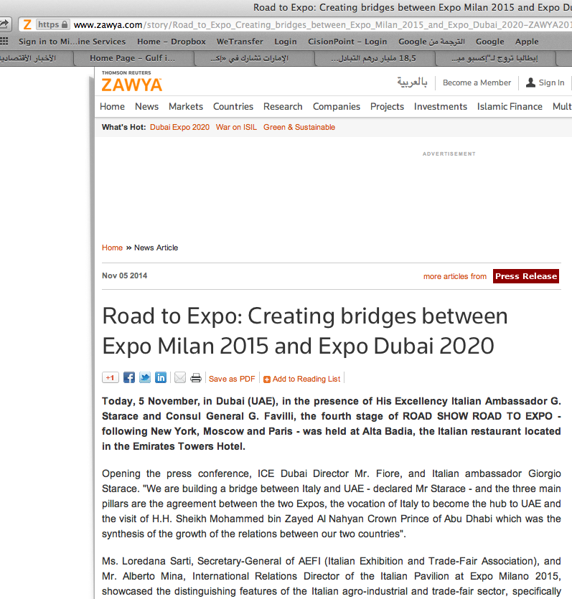
Publication | Type | Circulation/ Impressions | Date | Subject | AD value
Zawya | News Website | 411,007 | Nov , 6,2017 | Road to Expo 2015 press conference in Dubai | $ 3,250.00

Slide 29
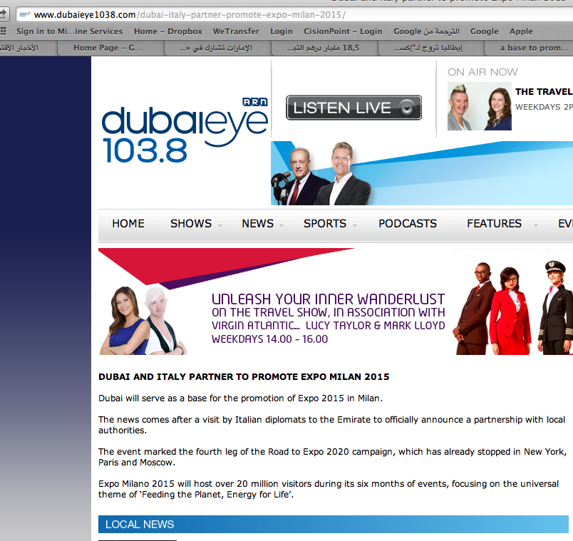
Publication | Type | Circulation/ Impressions | Date | Subject | AD value
Dubai eye | News Website |  | Nov , 6,2017 | Road to Expo 2015 press conference in Dubai | $ 3,250.00

Slide 30
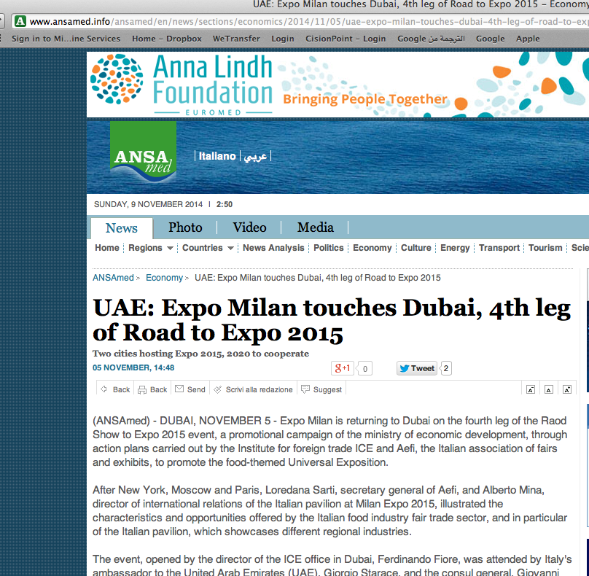
Publication | Type | Circulation/ Impressions | Date | Subject | AD value
Ansa Middle East | News Website |  | Nov , 5,2017 | Road to Expo 2015 press conference in Dubai | $ 3,250.00

Slide 31
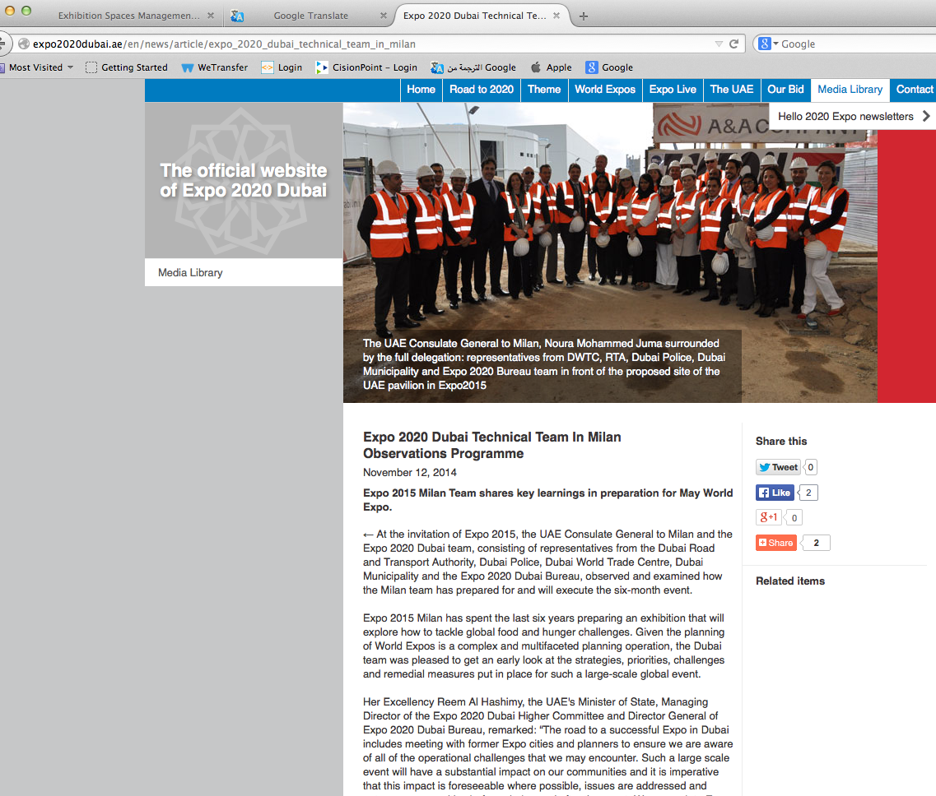
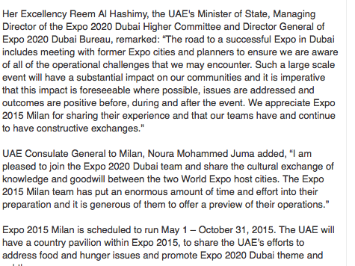
Publication | Type | Circulation/ Impressions | Date | Subject | AD value
Expo Dubai 2020 | News Website |  | Nov , 10,2017 | Road to Expo 2015 press conference in Dubai | $ 3,250.00

Slide 32
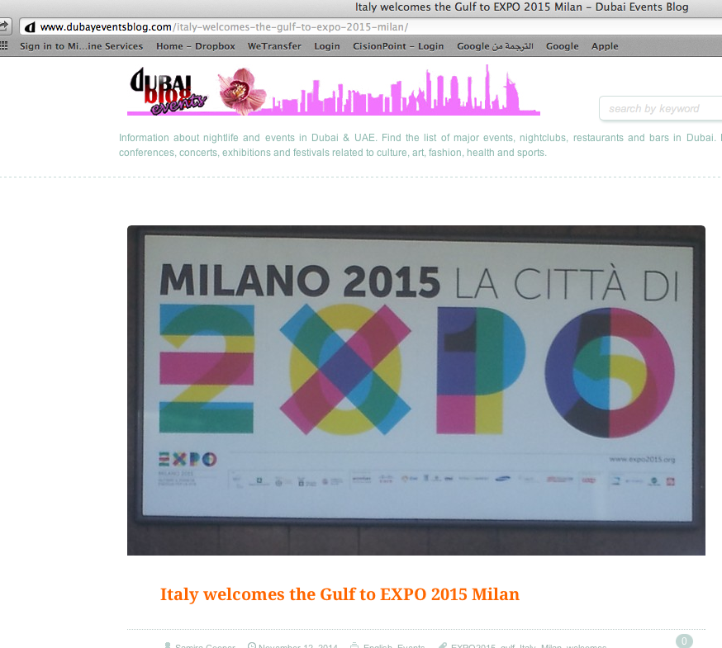
Publication | Type | Circulation/ Impressions | Date | Subject | AD value
Dubao events Blog | News Website |  | Nov , 12,2017 | Road to Expo 2015 press conference in Dubai | $ 3,250.00

Slide 33
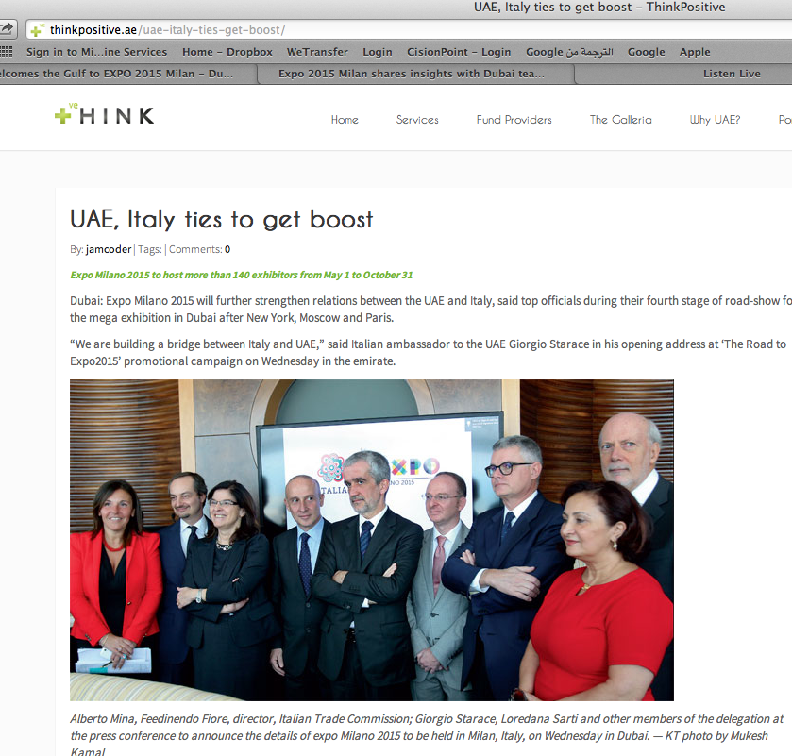
Publication | Type | Circulation/ Impressions | Date | Subject | AD value
Think Positive | News Website |  | Nov , 12,2017 | Road to Expo 2015 press conference in Dubai | $ 3,250.00

Slide 34
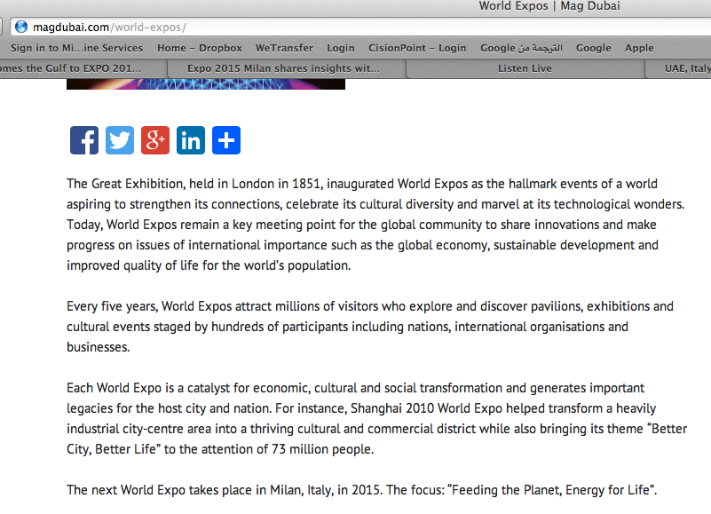
Publication | Type | Circulation/ Impressions | Date | Subject | AD value
Mag Dubai | News Website |  | Nov , 12,2017 | Road to Expo 2015 press conference in Dubai | $ 3,250.00

Slide 35
Broadcast

Slide 36
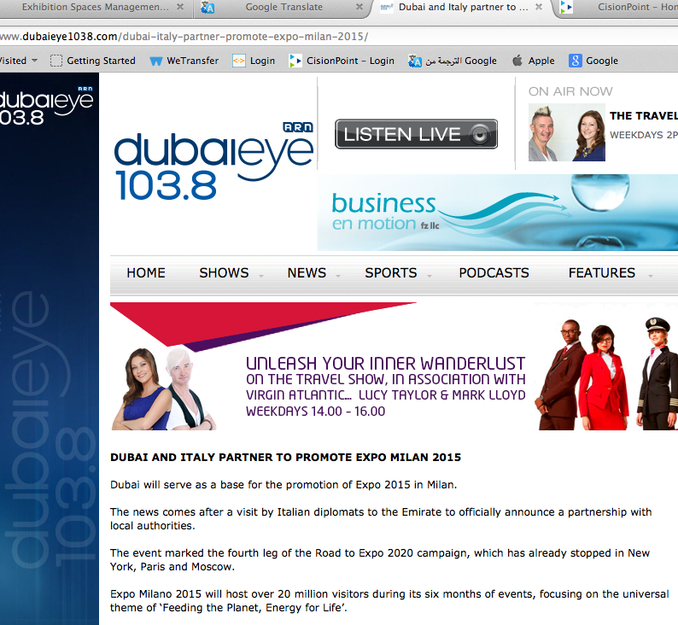
Publication | Type | Circulation/ Impressions | Date | Subject | AD value
Dubai eye | Radio station |  | Nov , 6,2017 | Road to Expo 2015 press conference in Dubai | $9,000

Slide 37
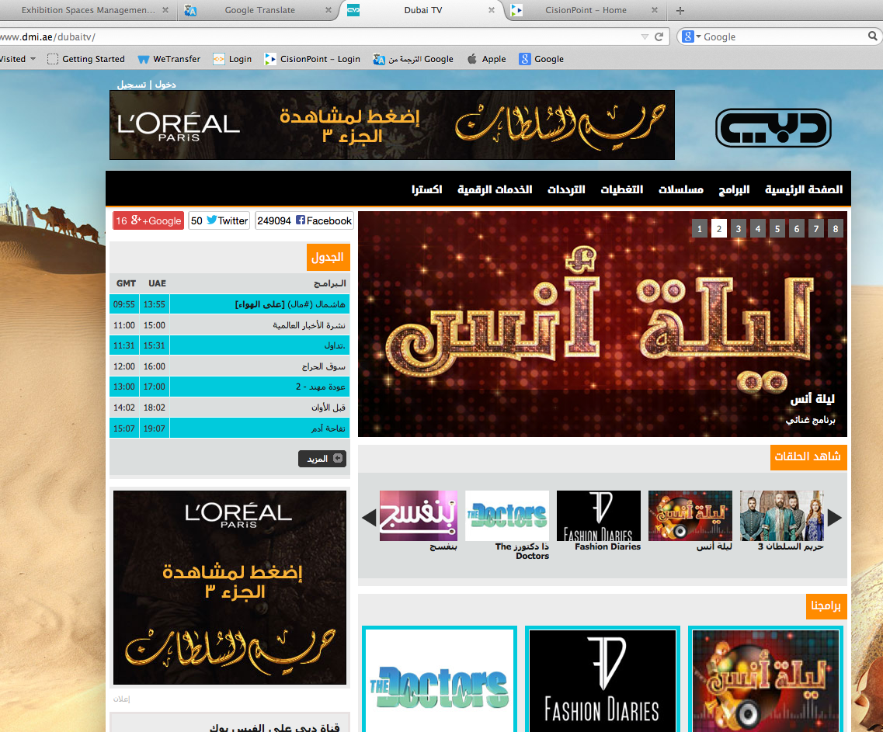
Publication | Type | Circulation/ Impressions | Date | Subject | AD value
Dubai TV | TV |  | Nov , 10,2017 | Road to Expo 2015 press conference in Dubai | $90,000

Slide 38
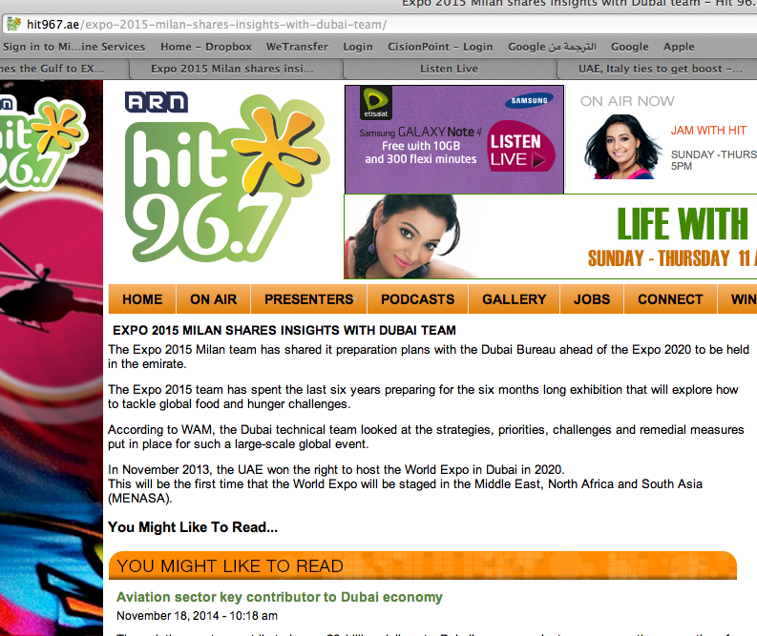
Publication | Type | Circulation/ Impressions | Date | Subject | AD value
Hit 96.7 | Radio |  | Nov , 12,2017 | Road to Expo 2015 press conference in Dubai | $9,000

